Slide 1
An Analysis of Pedestrian Safety in Cincinnati, Ohio
Patrick McDevitt
Preeti Swaminathan
Joshua Herrera
Raghuram Srinivas
02-Nov-2018

Slide 2
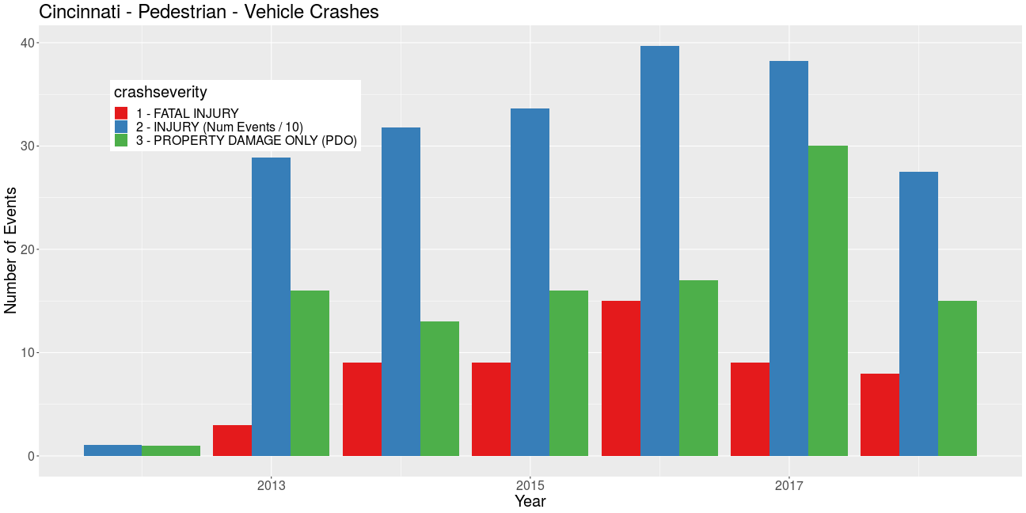
Cincinnati – Pedestrian Safety Experience
# Events
40
Property damage (/100)
Injuries (/10)
20
Fatalities
0
2013
2015
2017
Year
Fatalities : ~12 / year
Accidents w/ Injuries : 350 / year
Total Pedestrian Involved Accidents : 700 / year
1 / 2

Slide 3
Cincinnati – Pedestrian Safety Experience
# Events
40
Property damage (/100)
Injuries (/10)
20
Fatalities
0
2013
2015
2017
Year
Fatalities : ~12 / year
Accidents w/ Injuries : 350 / year
Total Pedestrian Involved Accidents : 700 / year

Slide 4
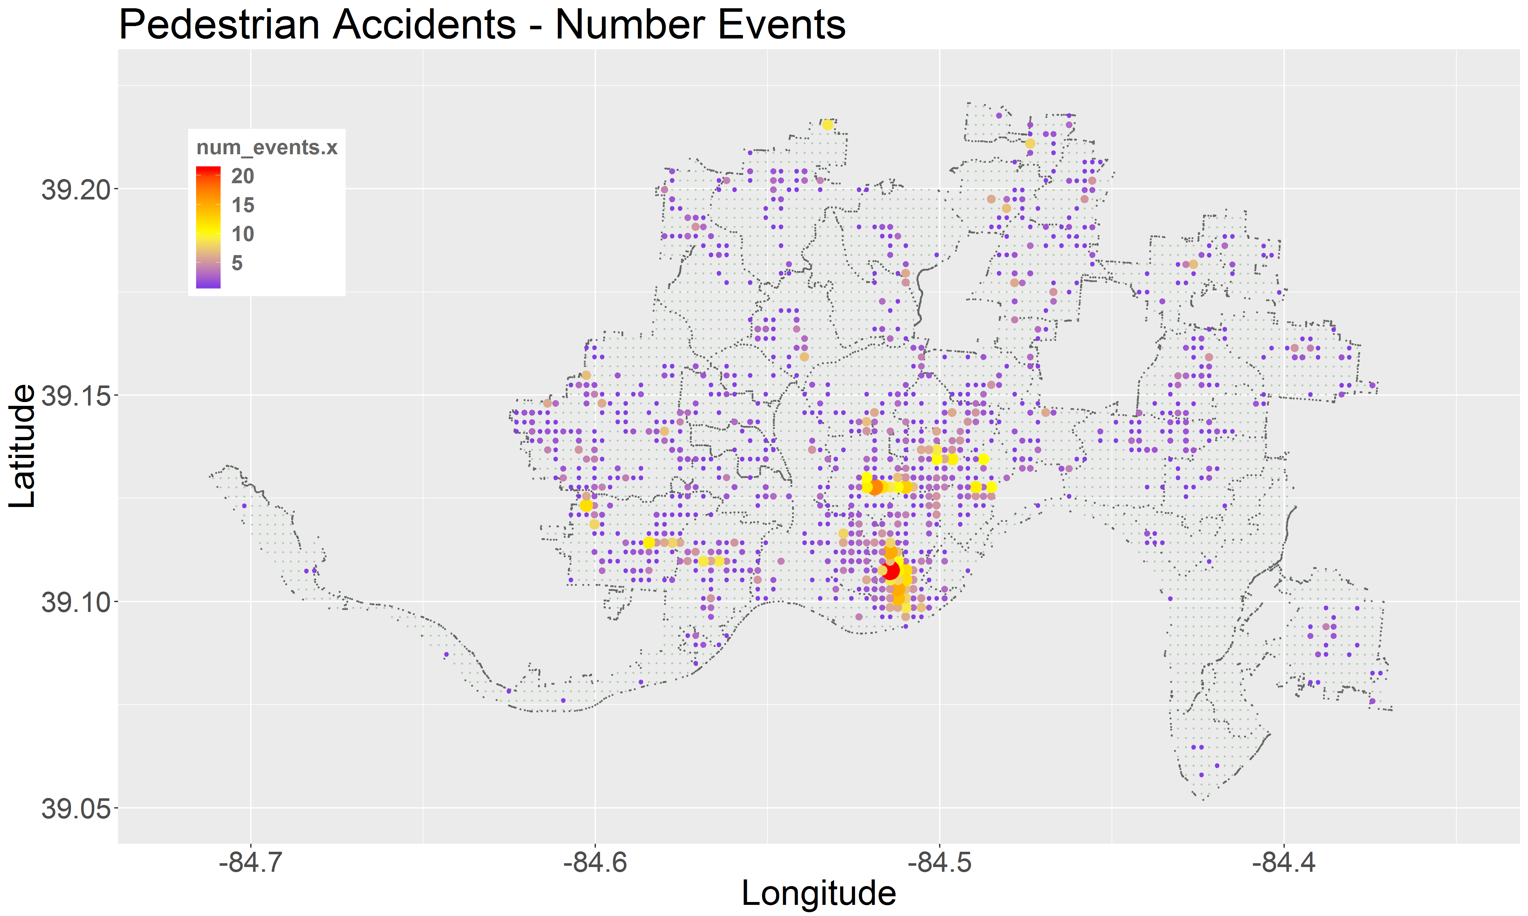
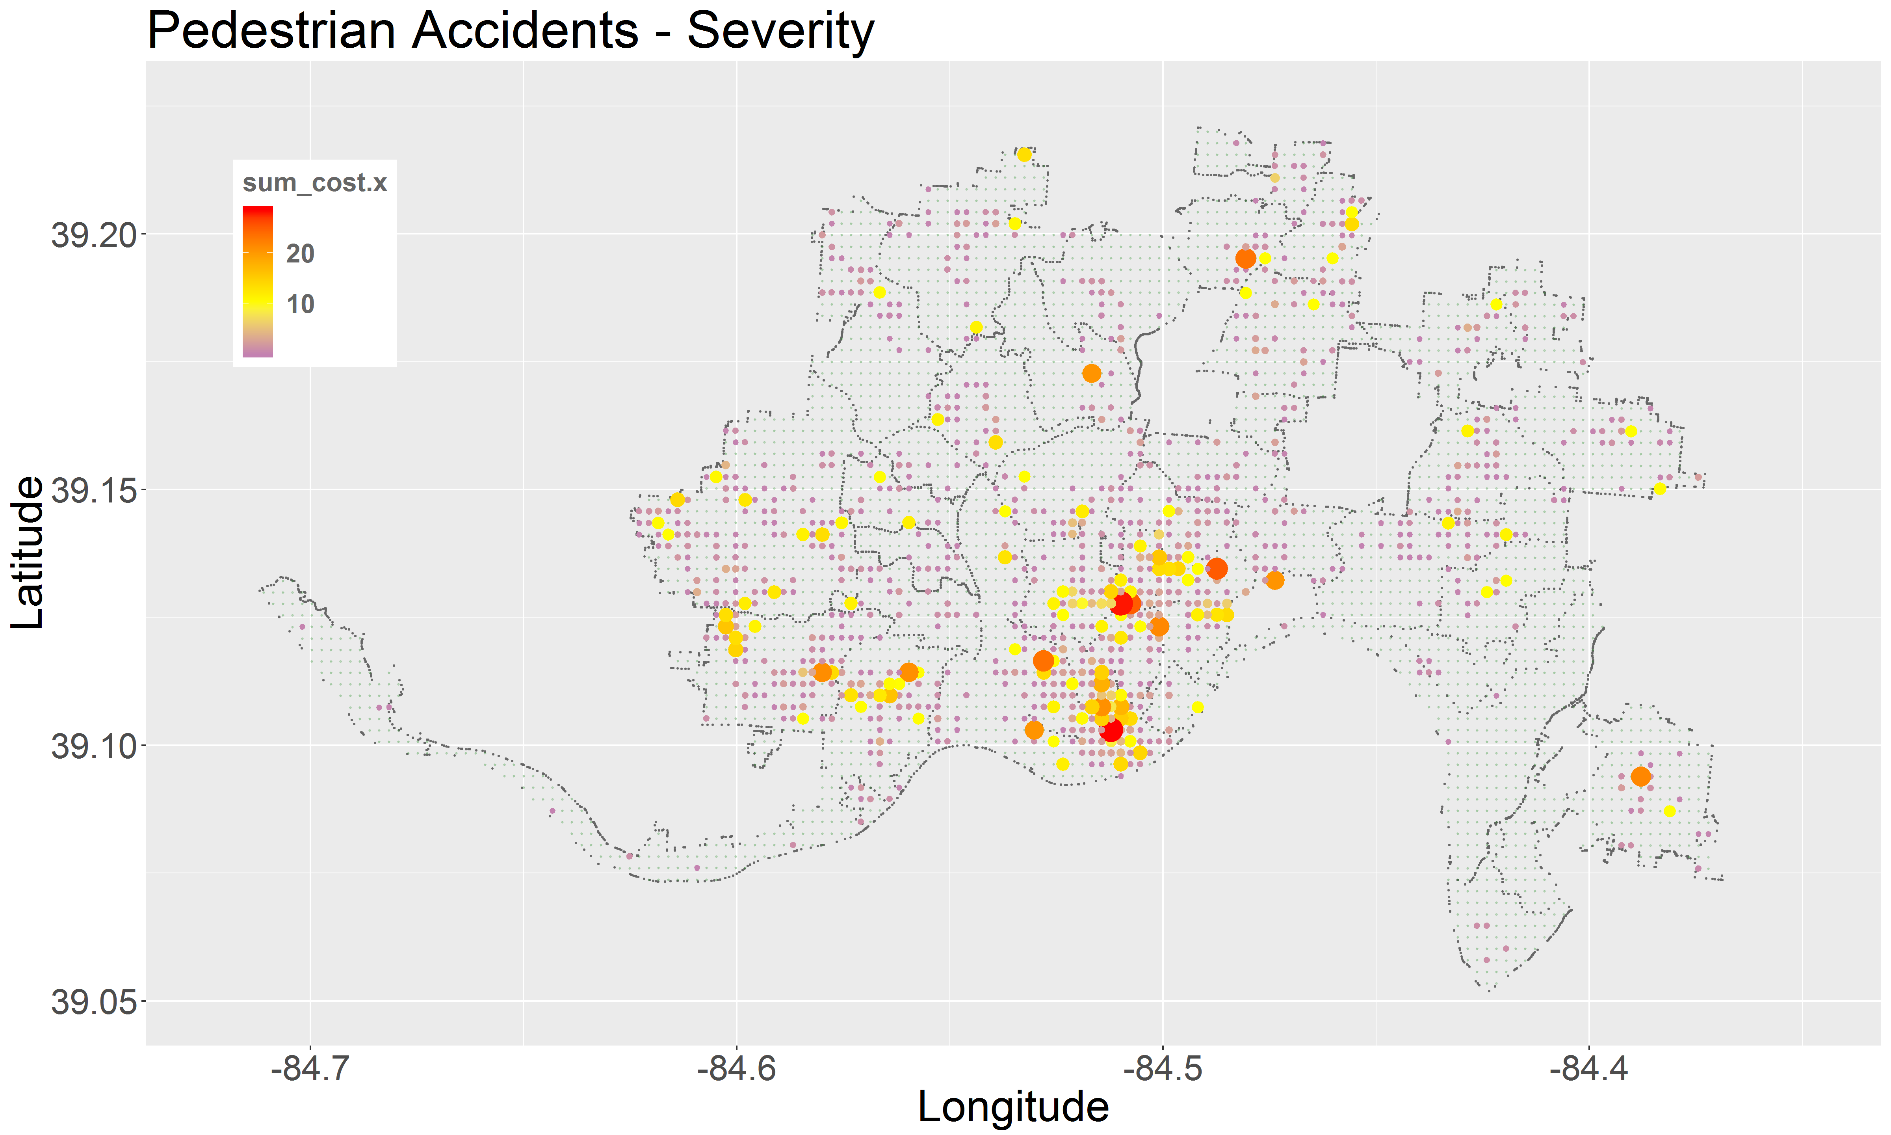
Pedestrian Accidents – Locations / Severity
Characteristics
widely dispersed across the city
heaviest concentration at city center & near east neighborhoods
National Safety Council estimated cost : $500M / year (all-in)
1 / 2

Slide 5
Pedestrian Accidents – Locations / Severity
Characteristics
widely dispersed across the city
heaviest concentration at city center & near east neighborhoods
National Safety Council estimated cost : $500M / year (all-in)

Slide 6
Model Concept – Grid Cell Aggregation
cell_id | 530045 | 630027 | 530038
Pedestrian Event Costs | 0.749 | 10.69 | 24.993
sum_cost.y | 973.74 | 1724.687 | 1796.4 | Traffic Accidents
num_events.y | 117 | 196 | 210
num_fire_incd | 0 | 0 | 0
med_sale_res_y | 50,000 | 989,016 | 13,356 | Property Values
med_sale_res_n | 25,600,000 | 12,815,000 | 33,618
med_sale_com_y | 27,413 | 351,822 | 8,303,951
med_sale_com_n | 25,600,000 | 25,600,000 | 25,600,000
med_sale_ind_y | 0 | 444,023 | 0
med_sale_ind_n | 0 | 0 | 0
med_sale_pbo_y | 0 | 0 | 0
med_sale_pbo_n | 0 | 0 | 0
mean_walk_score | 46 | 46 | 68 | Walk Score
min_walk_score | 44 | 44 | 67
max_walk_score | 48 | 48 | 69
num_walk_scores | 0 | 0 | 3
sum_lane_cnt | 206 | 89 | 517 | Street Surfaces
sum_width | 2024 | 907 | 5209
sum_area | 601532 | 122758 | 2745087
num_streets | 43 | 43 | 97
dist | 0.000416949 | 0.000330175 | 0.000343675 | Bus Dist
n_object | 3 | 12 | 6
animals_insects | 36 | 2 | 4 | Non-Emergency Service Requests
building.related | 203 | 38 | 52
construction | 0 | 0 | 0
food | 0 | 6 | 1
others | 124 | 155 | 156
police.property | 4 | 4 | 3
service.complaint | 2 | 1 | 1
street_sidewalk | 11 | 19 | 40
traffic_sig0l | 0 | 3 | 1
trash | 91 | 45 | 64
trees_plants | 8 | 3 | 29
water.leak | 2 | 1 | 1
zoning_parking | 0 | 0 | 1
n_request | 481 | 277 | 353
access | 0 | 0 | 0 | Pedestrian Survey
dblprk | 0 | 0 | 0
dnotyld | 0 | 0 | 0
jywalk | 0 | 0 | 0
lvisib | 0 | 0 | 0
lwfws | 0 | 0 | 0
nobikef | 0 | 0 | 0
noswlk | 0 | 0 | 0
other | 0 | 0 | 0
prkint | 0 | 0 | 0
prkswlk | 0 | 0 | 0
speed | 0 | 0 | 0
vrrlss | 0 | 0 | 0
wlksig | 0 | 0 | 0
xwalk | 0 | 0 | 0
assist | 0 | 0 | 0
bikes | 0 | 0 | 0
drives | 0 | 0 | 0
other.1 | 0 | 0 | 0
walks | 0 | 0 | 0
n_rqst | 0 | 0 | 0
num_near_misses | 0 | 0 | 0 | Misc
Pedestrian Accidents
Cost factor = Sum(accident * severity)
Event factor = Sum(number events)
Independent Estimators
Non-pedestrian accidents
Pedestrian survey responses
Reported near-misses
Street surface areas
Walk Scores
Fire incidents
Non-emergency service requests
Property values & uses
Public transportation accessibility
250m
250m
All events occurring within same geographic sector aggregated as a common response – predictor data set
1 / 2

Slide 7
Model Concept – Grid Cell Aggregation
cell_id | 530045 | 630027 | 530038
Pedestrian Event Costs | 0.749 | 10.69 | 24.993
sum_cost.y | 973.74 | 1724.687 | 1796.4 | Traffic Accidents
num_events.y | 117 | 196 | 210
num_fire_incd | 0 | 0 | 0
med_sale_res_y | 50,000 | 989,016 | 13,356 | Property Values
med_sale_res_n | 25,600,000 | 12,815,000 | 33,618
med_sale_com_y | 27,413 | 351,822 | 8,303,951
med_sale_com_n | 25,600,000 | 25,600,000 | 25,600,000
med_sale_ind_y | 0 | 444,023 | 0
med_sale_ind_n | 0 | 0 | 0
med_sale_pbo_y | 0 | 0 | 0
med_sale_pbo_n | 0 | 0 | 0
mean_walk_score | 46 | 46 | 68 | Walk Score
min_walk_score | 44 | 44 | 67
max_walk_score | 48 | 48 | 69
num_walk_scores | 0 | 0 | 3
sum_lane_cnt | 206 | 89 | 517 | Street Surfaces
sum_width | 2024 | 907 | 5209
sum_area | 601532 | 122758 | 2745087
num_streets | 43 | 43 | 97
dist | 0.000416949 | 0.000330175 | 0.000343675 | Bus Dist
n_object | 3 | 12 | 6
animals_insects | 36 | 2 | 4 | Non-Emergency Service Requests
building.related | 203 | 38 | 52
construction | 0 | 0 | 0
food | 0 | 6 | 1
others | 124 | 155 | 156
police.property | 4 | 4 | 3
service.complaint | 2 | 1 | 1
street_sidewalk | 11 | 19 | 40
traffic_sig0l | 0 | 3 | 1
trash | 91 | 45 | 64
trees_plants | 8 | 3 | 29
water.leak | 2 | 1 | 1
zoning_parking | 0 | 0 | 1
n_request | 481 | 277 | 353
access | 0 | 0 | 0 | Pedestrian Survey
dblprk | 0 | 0 | 0
dnotyld | 0 | 0 | 0
jywalk | 0 | 0 | 0
lvisib | 0 | 0 | 0
lwfws | 0 | 0 | 0
nobikef | 0 | 0 | 0
noswlk | 0 | 0 | 0
other | 0 | 0 | 0
prkint | 0 | 0 | 0
prkswlk | 0 | 0 | 0
speed | 0 | 0 | 0
vrrlss | 0 | 0 | 0
wlksig | 0 | 0 | 0
xwalk | 0 | 0 | 0
assist | 0 | 0 | 0
bikes | 0 | 0 | 0
drives | 0 | 0 | 0
other.1 | 0 | 0 | 0
walks | 0 | 0 | 0
n_rqst | 0 | 0 | 0
num_near_misses | 0 | 0 | 0 | Misc
Pedestrian Accidents
Cost factor = Sum(accident * severity)
Event factor = Sum(number events)
Independent Estimators
Non-pedestrian accidents
Pedestrian survey responses
Reported near-misses
Street surface areas
Walk Scores
Fire incidents
Non-emergency service requests
Property values & uses
Public transportation accessibility
250m
250m
All events occurring within same geographic sector aggregated as a common response – predictor data set

Slide 8
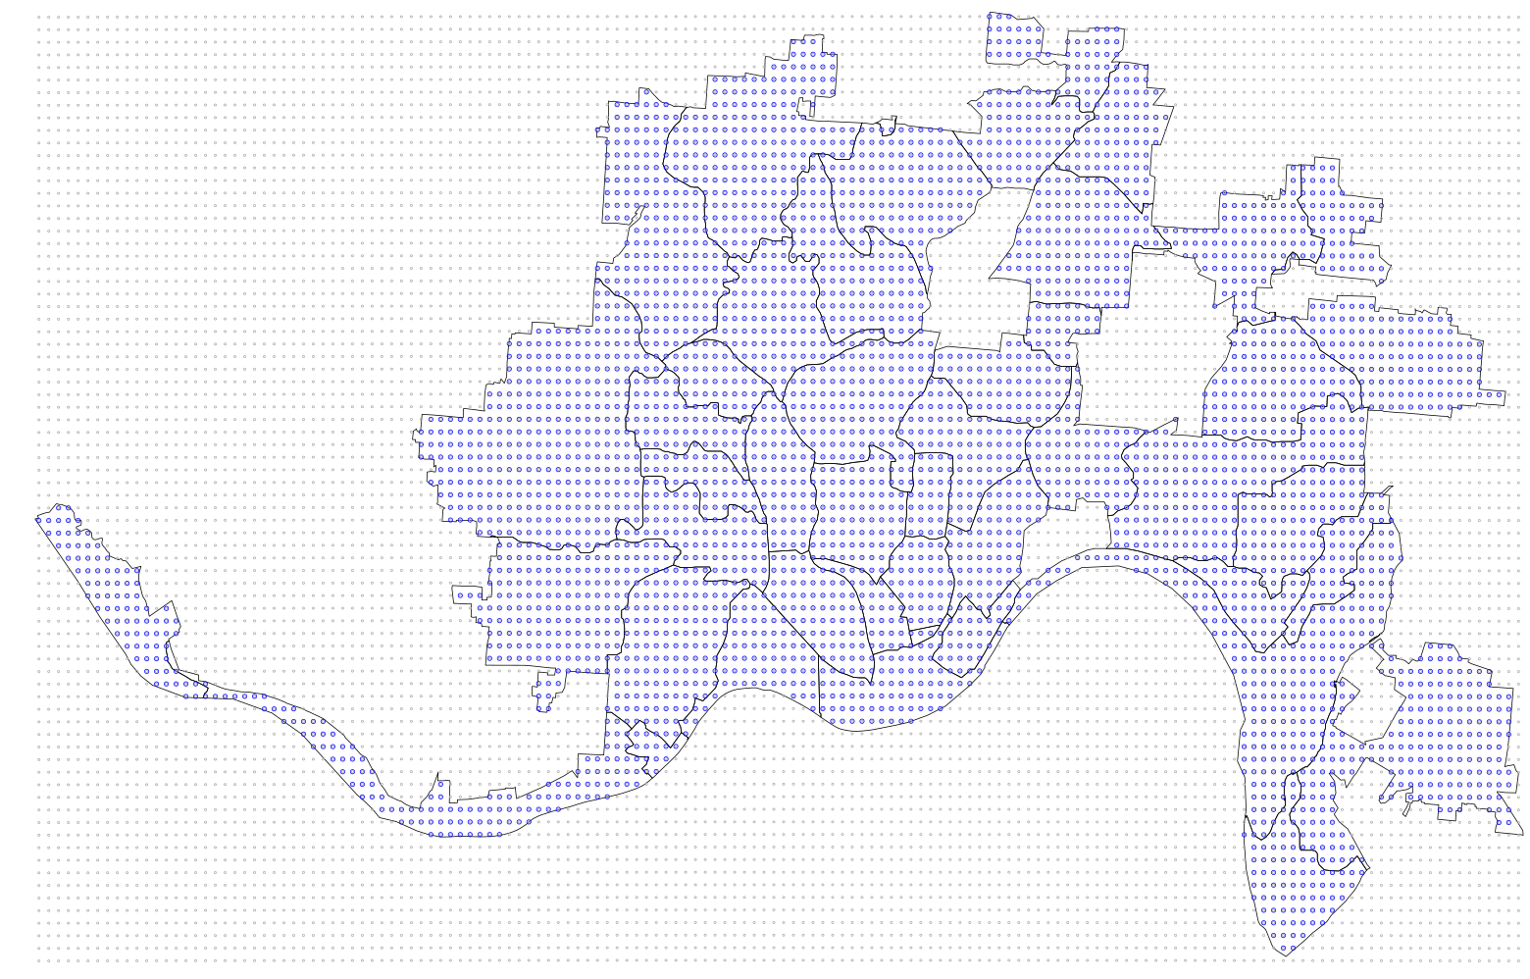
Analysis Method Concept
Grid cell approach
Accumulate experience of candidate features in each cell
Grid cell size : 250m x 250m
uniform distribution, equidistant edge distances
4196 grid cells
(~80 sq-miles)

Slide 9
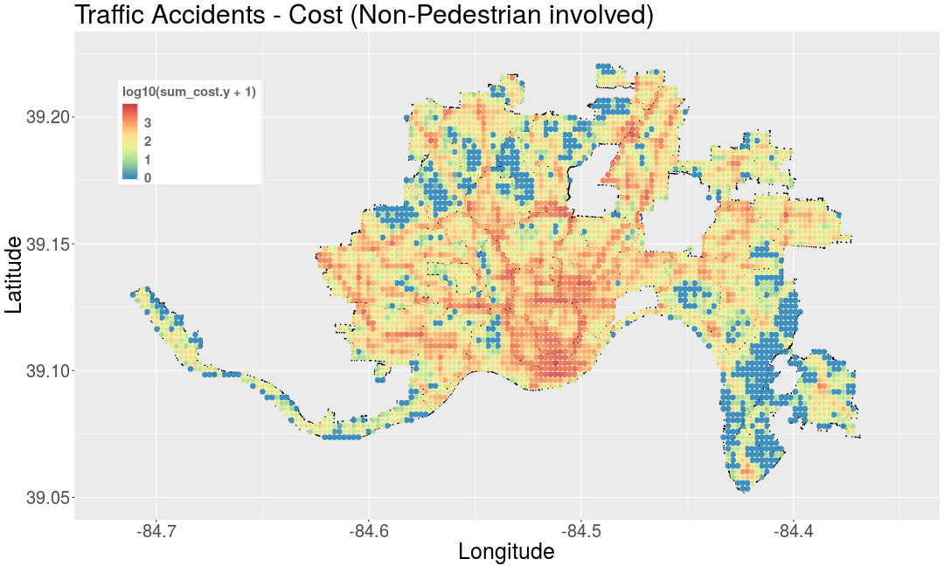
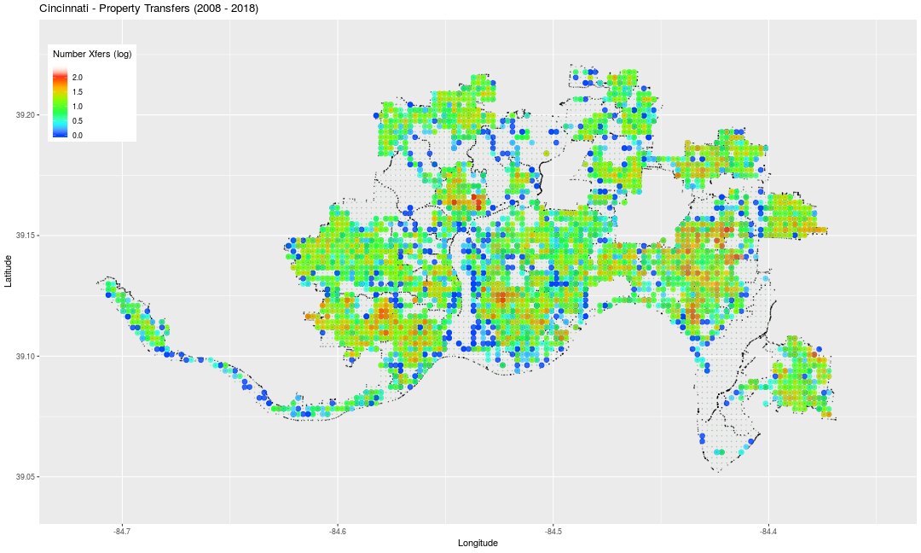
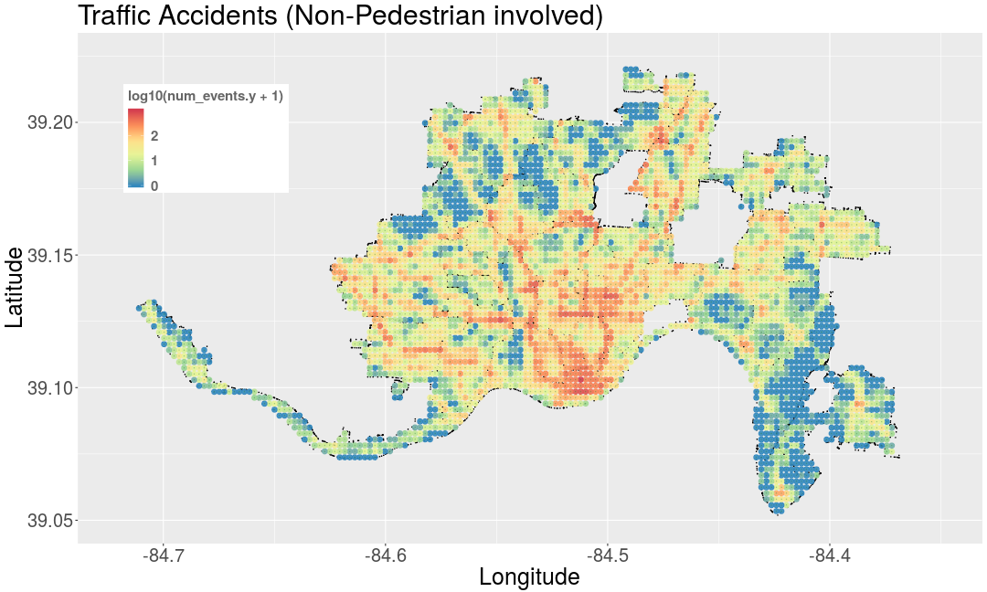
Traffic Accidents (Non-Pedestrian) / Property Values
Costs (NSC model)
Accident Density
Distribution of Property Values (median)
190,000 accidents
426 fatalities

Slide 10
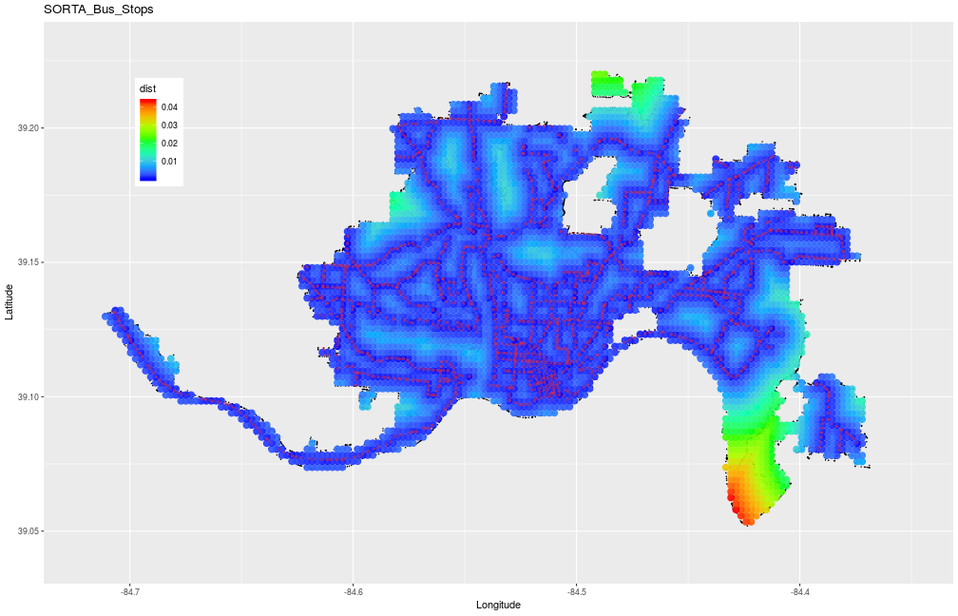
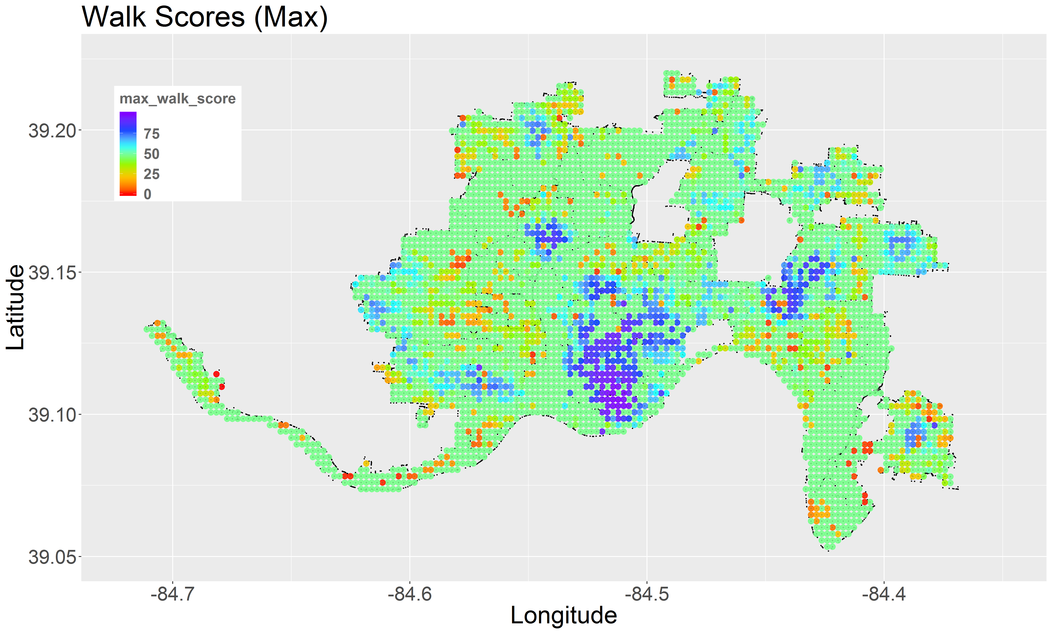
Transportation / Walk-ability
Walkable (blue)
Not Walkable (red)
Public transportation accessibility
distance to nearest bus stop
Walk Score – scale from 0 – 100
walking distances, block length, intersection density
calculated every city block
weighted by population density

Slide 11
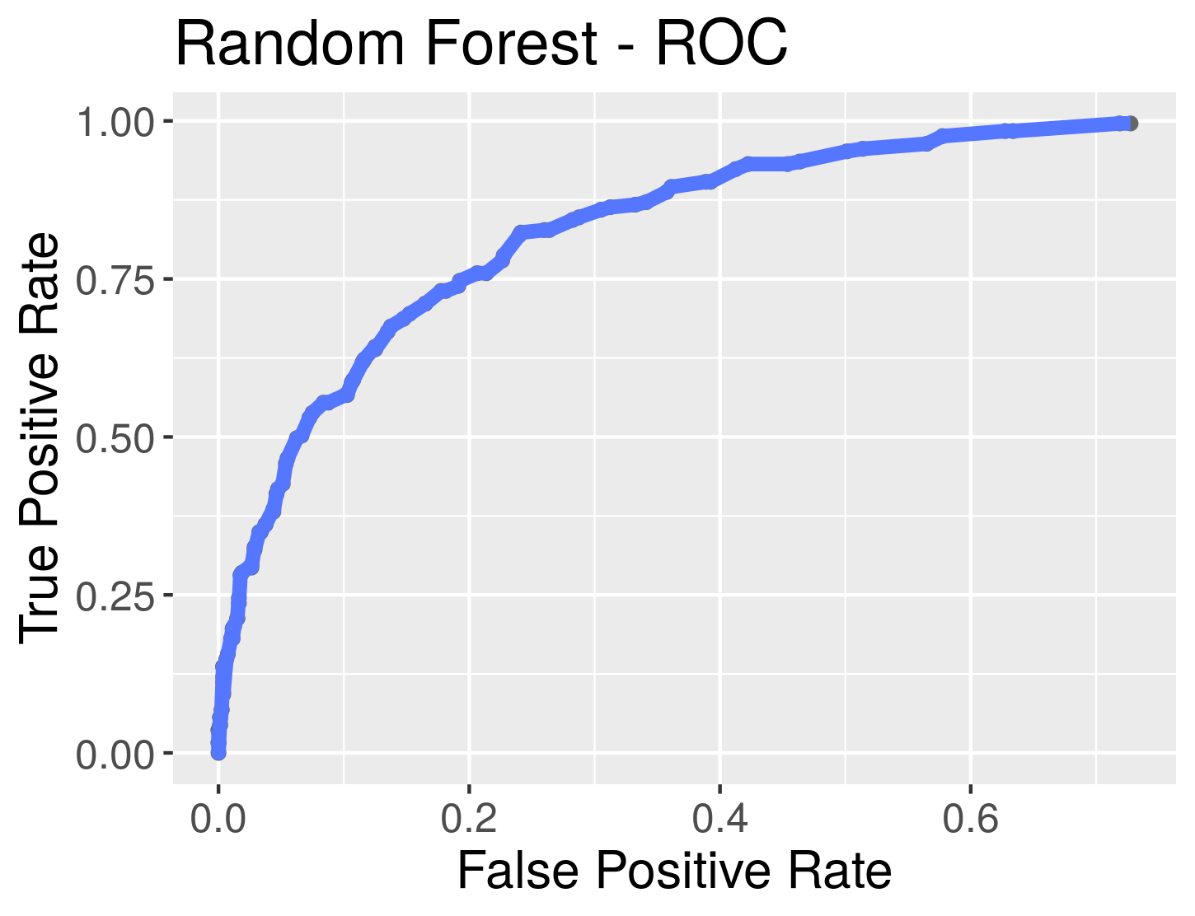
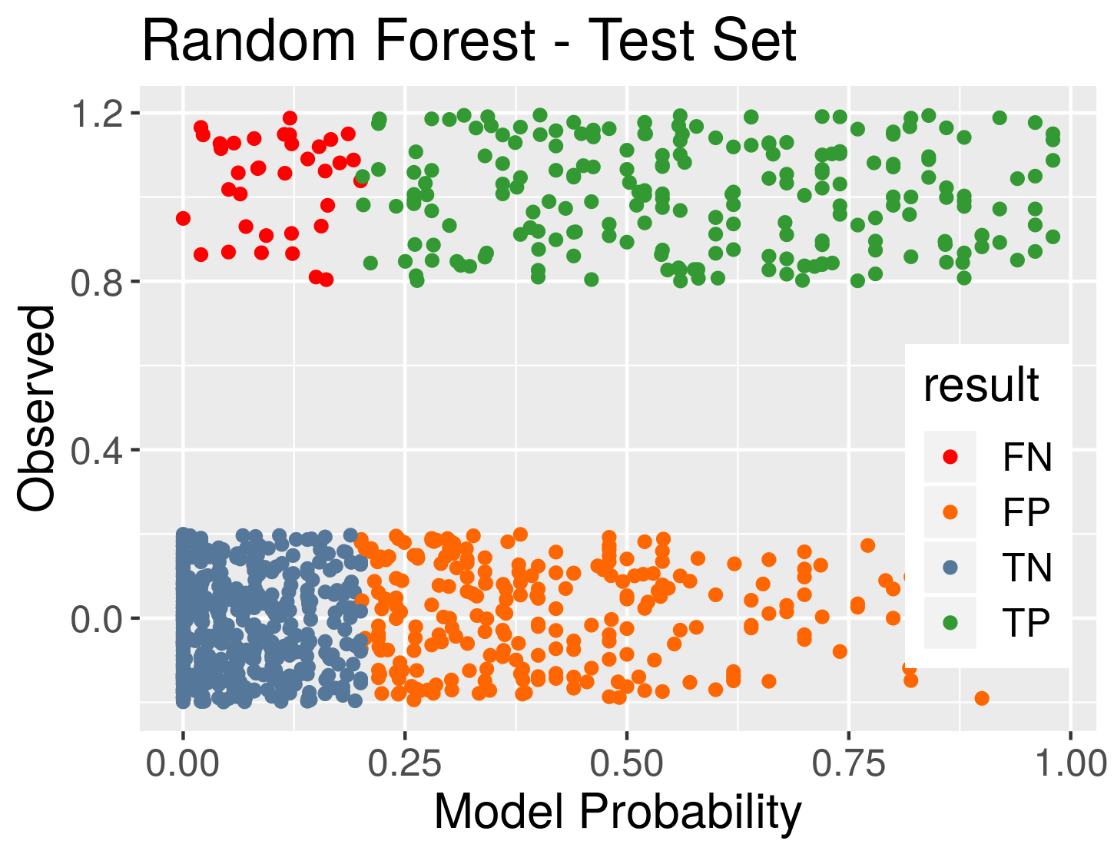
Random Forest Analysis
Binary & Cost Models implemented
Binary model provides useful results
~75% TPR / 20% FPR
Influential factors
Non-pedestrian involved accidents
Public transportation accessibility
Number of service requests for buildings, sidewalk, and vegetation
Regions w/ pedestrian events
Potential for Safety Improvement (PSI)
Regions of no events
1 / 2

Slide 12
Random Forest Analysis
Binary & Cost Models implemented
Binary model provides useful results
~75% TPR / 20% FPR
Influential factors
Non-pedestrian involved accidents
Public transportation accessibility
Number of service requests for buildings, sidewalk, and vegetation
Regions w/ pedestrian events
Potential for Safety Improvement (PSI)
Regions of no events

Slide 13
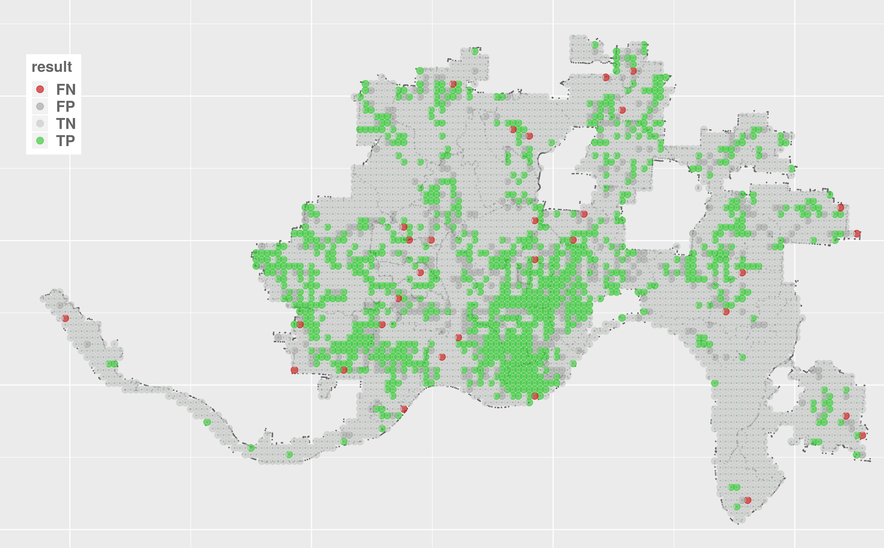
Random Forest – Geographic View
Strong contiguity for TP, FP, FN regions
Large surface areas of TN – high model accuracy
PSI identification (FN) perimeter of TP regions
Widely distributed (consistent with experience of accidents)
Some at perimeter of city incorporation boundary
Reasonable number of specific regions for further investigation
Red = Potential for Safety Improvement

Slide 14
Random Forest – Geographic View
Strong contiguity for TP, FP, FN regions
Large surface areas of TN – high model accuracy
PSI identification (FN) perimeter of TP regions
Widely distributed (consistent with experience of accidents)
Some at perimeter of city incorporation boundary
Reasonable number of specific regions for further investigation
Red = Potential for Safety Improvement

Slide 15
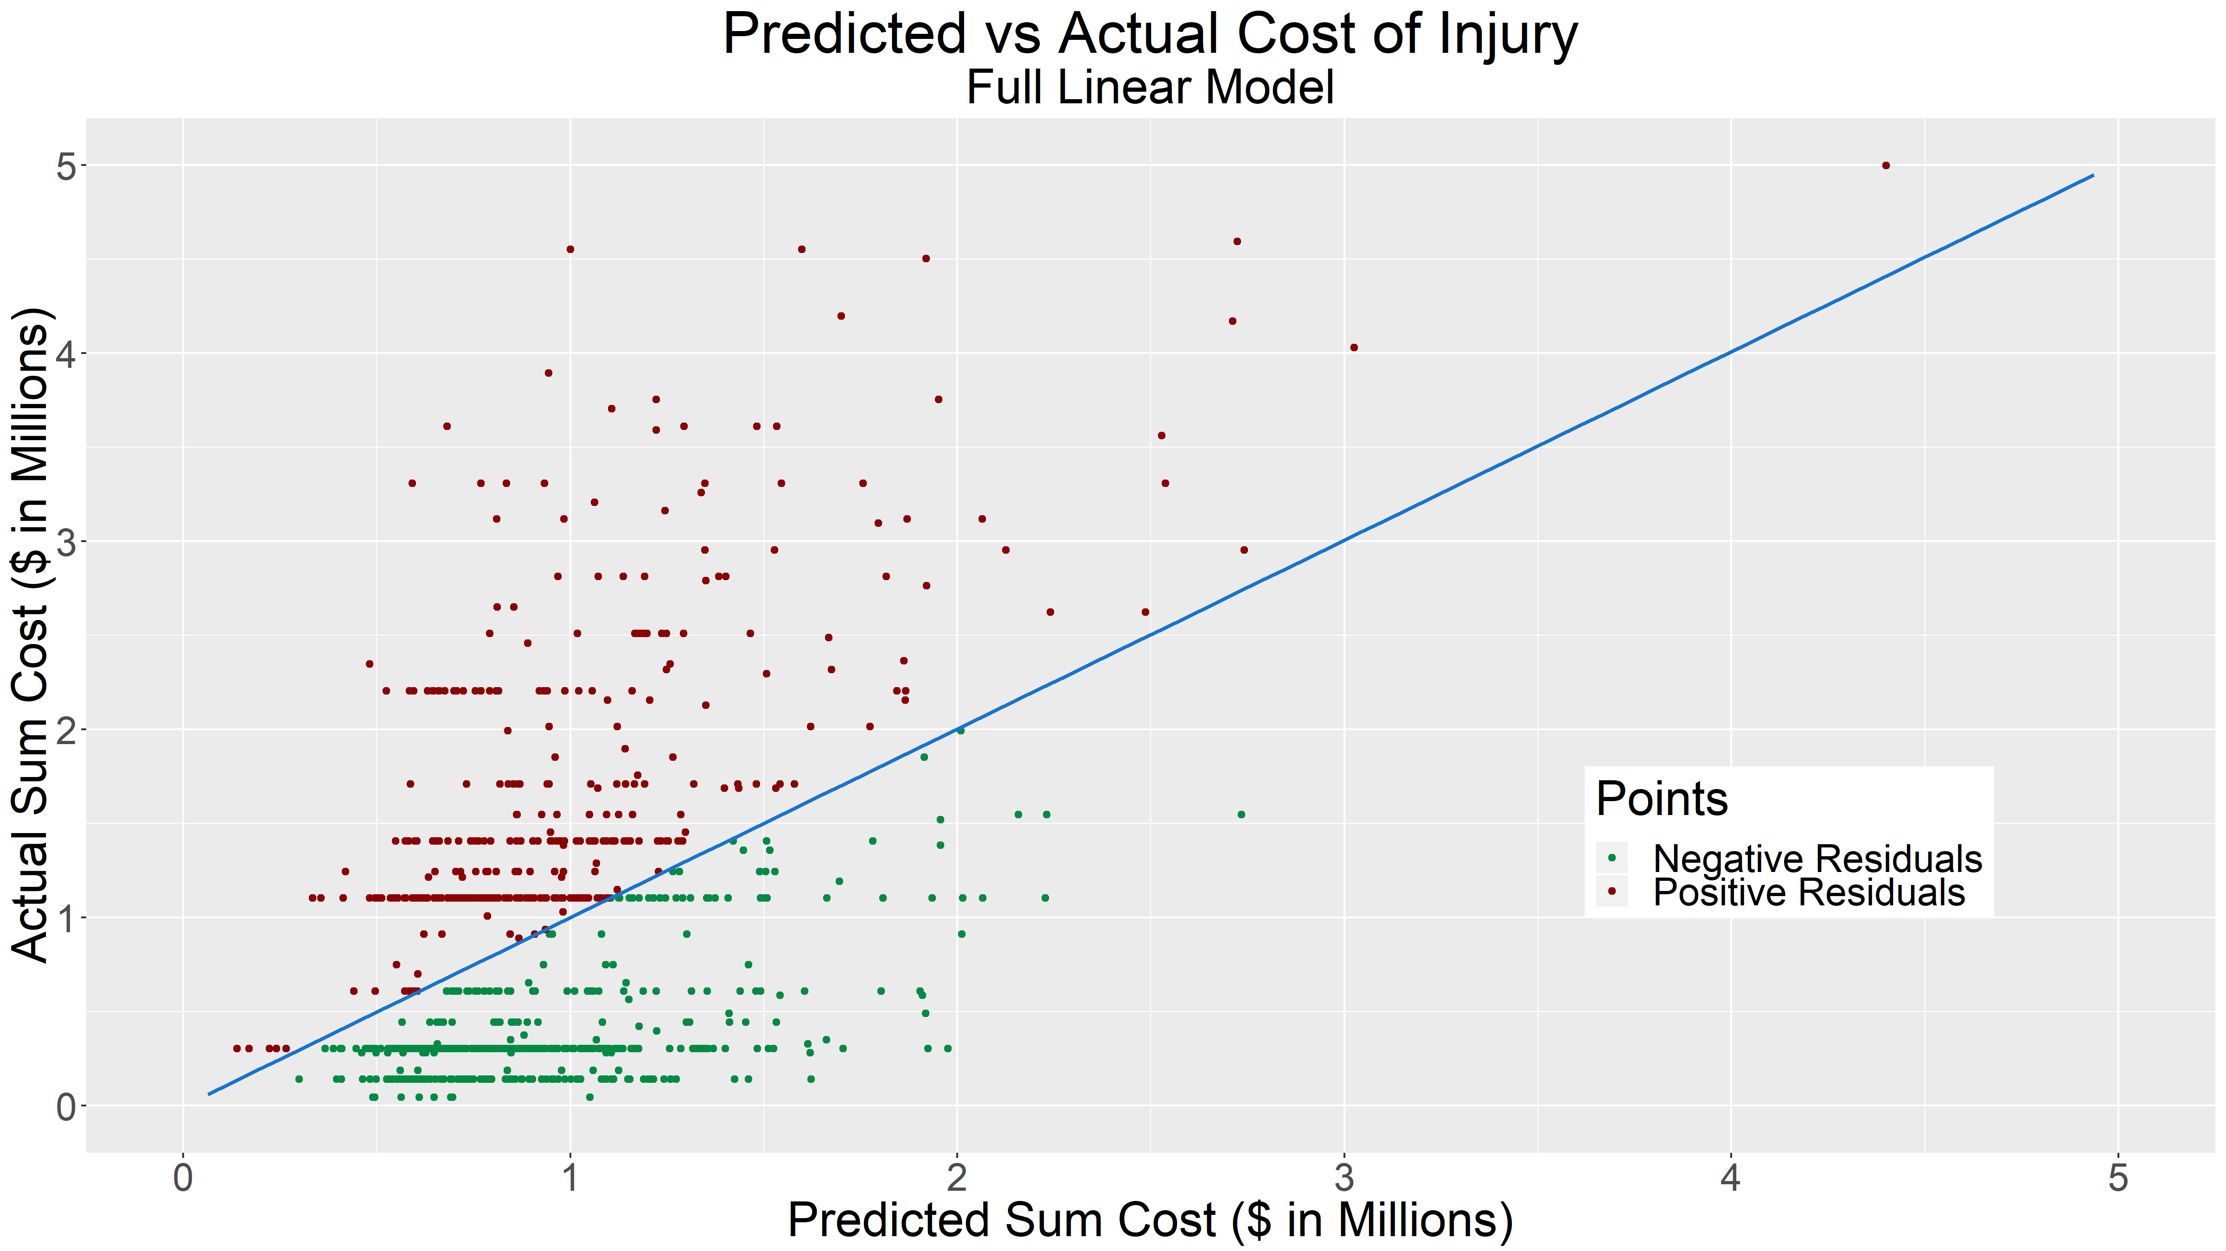
Regression Analysis

Slide 16
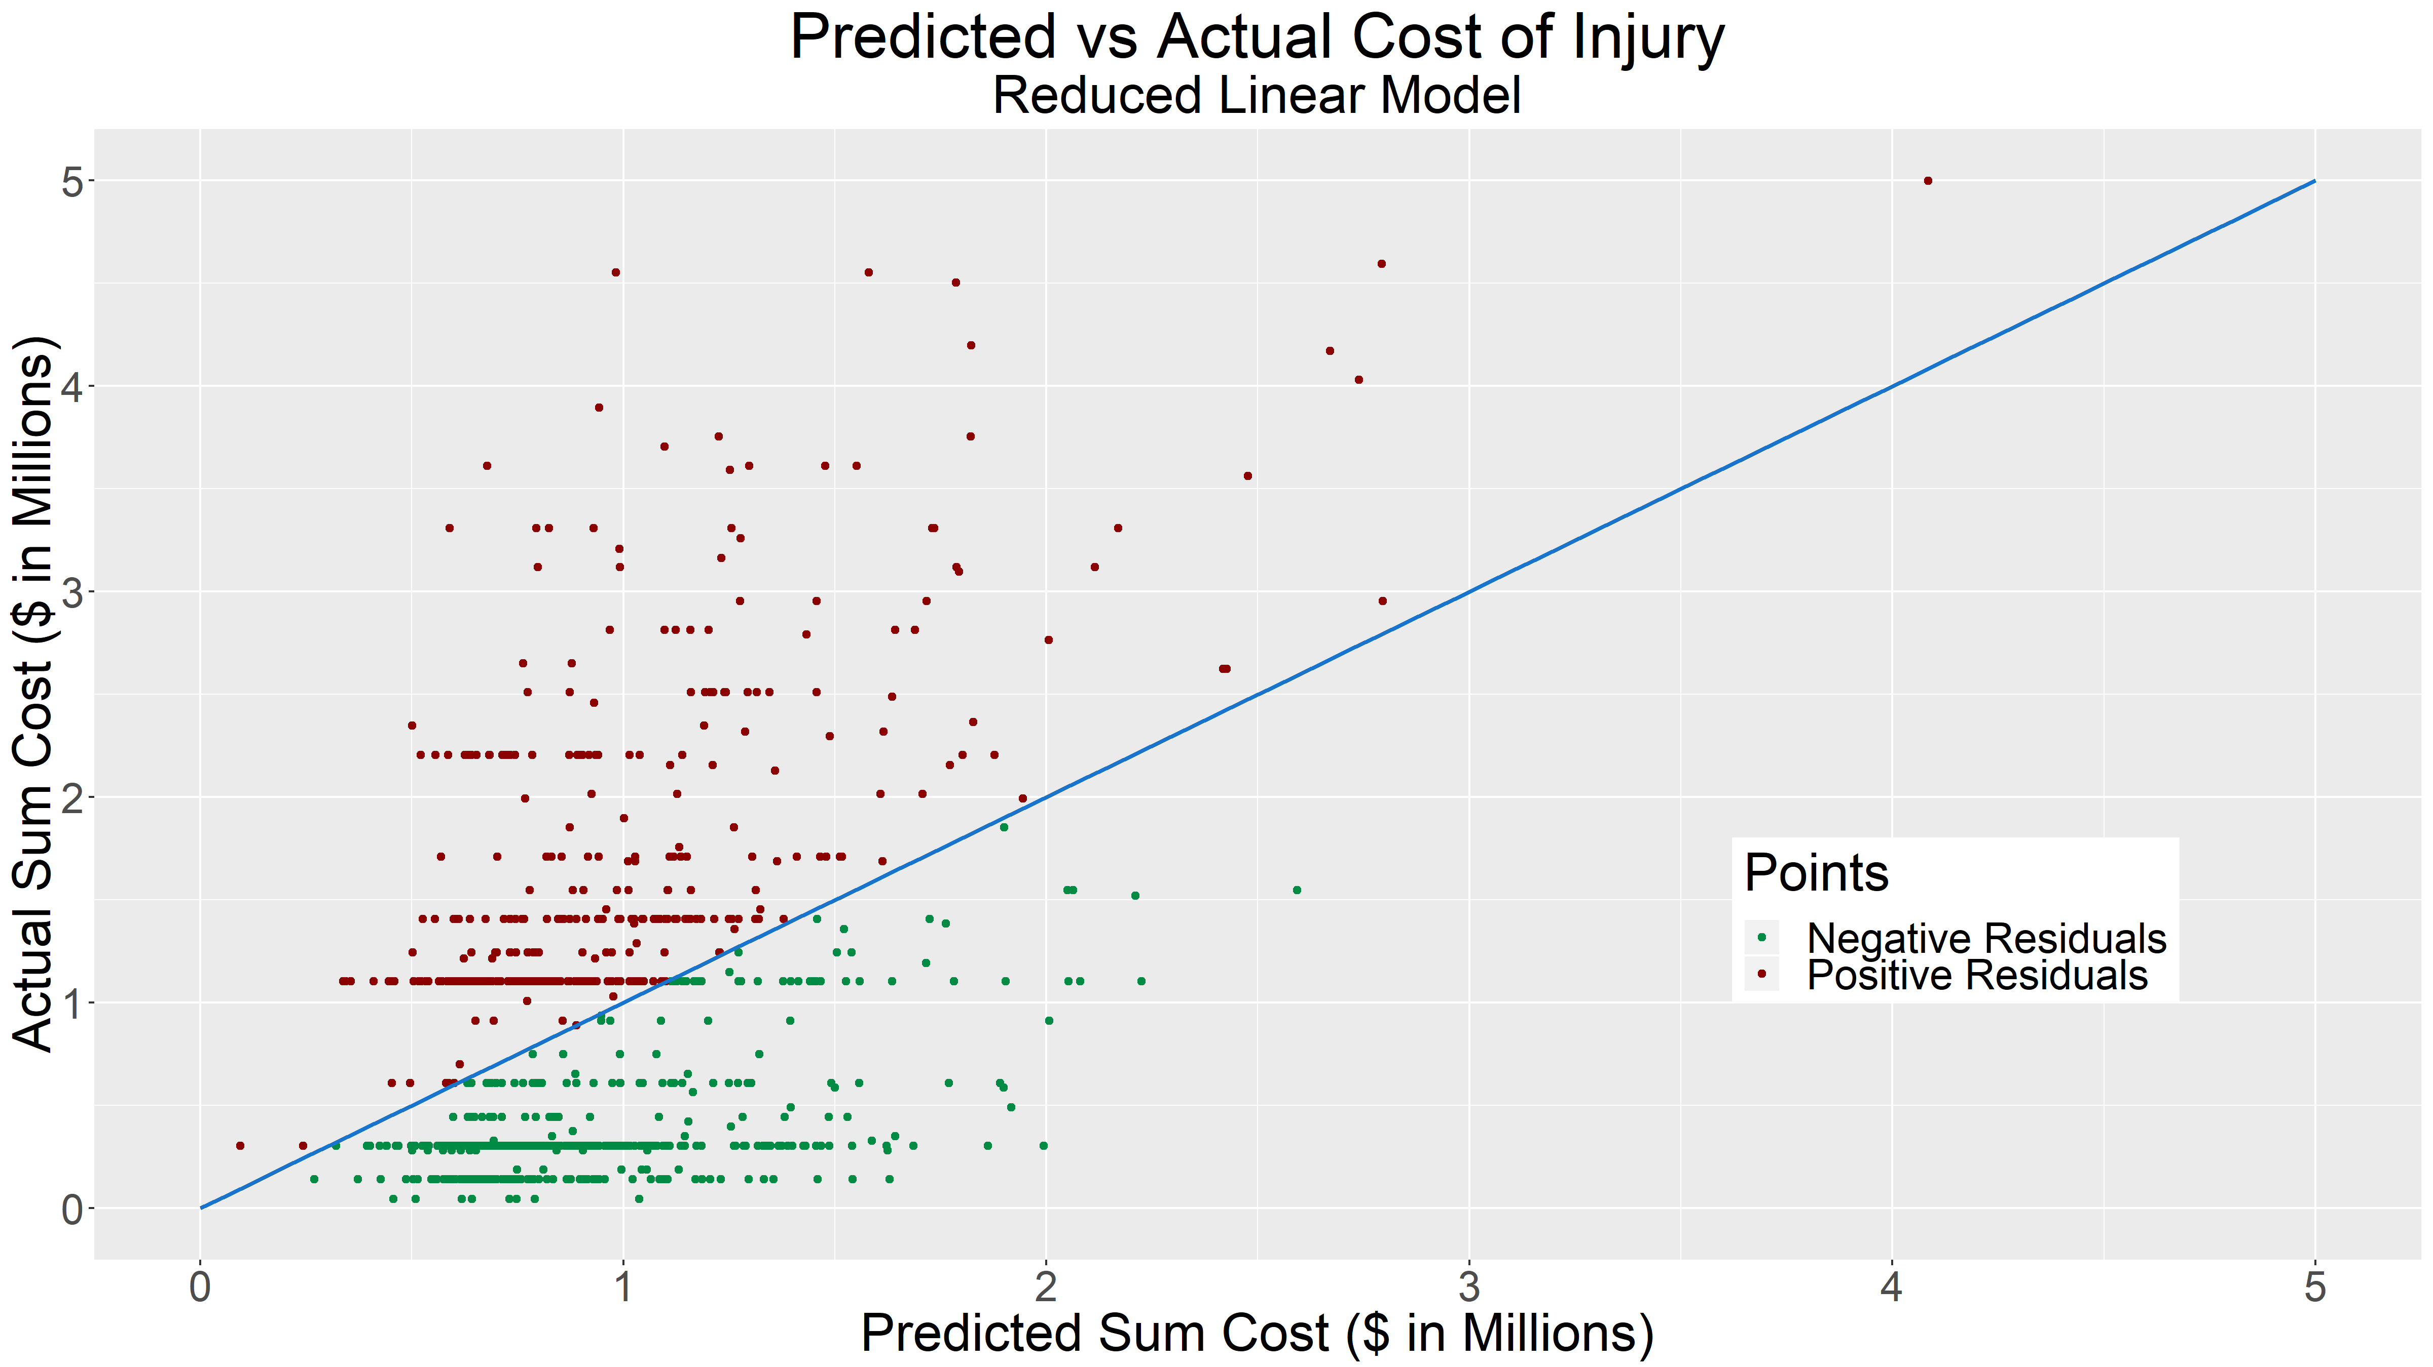
Regression Analysis – Cont.

Slide 17
Variable Analysis
Coefficients Sorted by Significance
 | Estimate ($) | Std. Error ($) | t value | Pr(>|t|)
Sum Cost of Damage to People in Non-Pedestrian Accidents | 267 | 31.8 | 8.391 | < 2e-16
Unsanitary Food Operations | 39,796 | 8,189 | 4.86 | 1.40E-06
Intercept | 310,397 | 90,519 | 3.429 | 0.00064
Maximum Walk Score | 5,638 | 1758 | 3.207 | 0.00139
Water Leaks and Breaks | -72,140 | 24,776 | -2.912 | 0.00369
Crosswalk Needed | 117,618 | 45,848 | 2.565 | 0.01048
Number of Police Properties | 14,442 | 5,850 | 2.469 | 0.01377
Vehicles Running Red Lights / Stop Signs | 50,332 | 24,291 | 2.072 | 0.03856
Unkempt Flora | 3,998 | 2,158 | 1.853 | 0.06429
Speeding | -62,700 | 34,132 | -1.837 | 0.06658
Parking Close to Intersection | -146,340 | 82,879 | -1.766 | 0.07781
Parking on Sidewalk | 257,246 | 147,334 | 1.746 | 0.08117
Reports of:
Parking on Sidewalk
Crosswalks Needed
Vehicles Running Red Lights / Stop Signs
Unsanitary Food Operations
Unkempt Flora
Speeding
Water Leaks and Breaks
Parking Close to Intersection
All changed the estimated pedestrian injury cost by the shown amount.
The number of police properties within an area affected the estimated pedestrian injury cost. The total cost of damage to people involved in non-pedestrian accidents (in millions) affects the estimated cost of pedestrian injuries.
Coefficients below this point are not significant at a p-value of 0.05, but are suggestive of being relevant to the model’s predictive capabilities (p-value <0.1).

Slide 18
Variable Analysis – Cont. 1/2
Coefficients Sorted by Estimate
 | Estimate ($) | Std. Error ($) | t value | Pr(>|t|)
Intercept | 310,397 | 90,519 | 3.429 | 0.00064
Parking on Sidewalk | 257,246 | 147,334 | 1.746 | 0.08117
Crosswalk Needed | 117,618 | 45,848 | 2.565 | 0.01048
Vehicles Running Red Lights / Stop Signs | 50,332 | 24,291 | 2.072 | 0.03856
Unsanitary Food Operations | 39,796 | 8,189 | 4.86 | 1.40E-06
Number of Police Properties | 14,442 | 5,850 | 2.469 | 0.01377
Maximum Walk Score | 5,638 | 1758 | 3.207 | 0.00139
Unkempt Flora | 3,998 | 2,158 | 1.853 | 0.06429
Sum Cost of Damage to People in Non-Pedestrian Accidents | 267 | 31.8 | 8.391 | < 2e-16
Speeding | -62,700 | 34,132 | -1.837 | 0.06658
Water Leaks and Breaks | -72,140 | 24,776 | -2.912 | 0.00369
Parking Close to Intersection | -146,340 | 82,879 | -1.766 | 0.07781
Reports of:
Parking on Sidewalk
Crosswalks Needed
Vehicles Running Red Lights / Stop Signs
Unsanitary Food Operations
Unkempt Flora
Speeding
Water Leaks and Breaks
Parking Close to Intersection
All changed the estimated pedestrian injury cost by the shown amount.
The number of police properties within an area affected the estimated pedestrian injury cost.
The total cost of damage to people involved in non-pedestrian accidents (in millions) affects the estimated cost of pedestrian injuries.

Slide 19
Variable Analysis – Cont. 1/2
Coefficients Sorted by Estimate
 | Estimate ($) | Std. Error ($) | t value | Pr(>|t|)
Intercept | 310,397 | 90,519 | 3.429 | 0.00064
Parking on Sidewalk | 257,246 | 147,334 | 1.746 | 0.08117
Crosswalk Needed | 117,618 | 45,848 | 2.565 | 0.01048
Vehicles Running Red Lights / Stop Signs | 50,332 | 24,291 | 2.072 | 0.03856
Unsanitary Food Operations | 39,796 | 8,189 | 4.86 | 1.40E-06
Number of Police Properties | 14,442 | 5,850 | 2.469 | 0.01377
Maximum Walk Score | 5,638 | 1758 | 3.207 | 0.00139
Unkempt Flora | 3,998 | 2,158 | 1.853 | 0.06429
Sum Cost of Damage to People in Non-Pedestrian Accidents | 267 | 31.8 | 8.391 | < 2e-16
Speeding | -62,700 | 34,132 | -1.837 | 0.06658
Water Leaks and Breaks | -72,140 | 24,776 | -2.912 | 0.00369
Parking Close to Intersection | -146,340 | 82,879 | -1.766 | 0.07781
Reports of:
Parking on Sidewalk
Crosswalks Needed
Vehicles Running Red Lights / Stop Signs
Unsanitary Food Operations
Unkempt Flora
Speeding
Water Leaks and Breaks
Parking Close to Intersection
All changed the estimated pedestrian injury cost by the shown amount.
The number of police properties within an area affected the estimated pedestrian injury cost.
The total cost of damage to people involved in non-pedestrian accidents (in millions) affects the estimated cost of pedestrian injuries.

Slide 20
Terms Explained
Model has underestimated cost
Potential for safety improvement
Model has overestimated cost
Suggested to be high risk

Slide 21
Terms Explained - Cont.
Model has underestimated cost
Potential for safety improvement
Model has overestimated cost
Suggested to be high risk

Slide 22
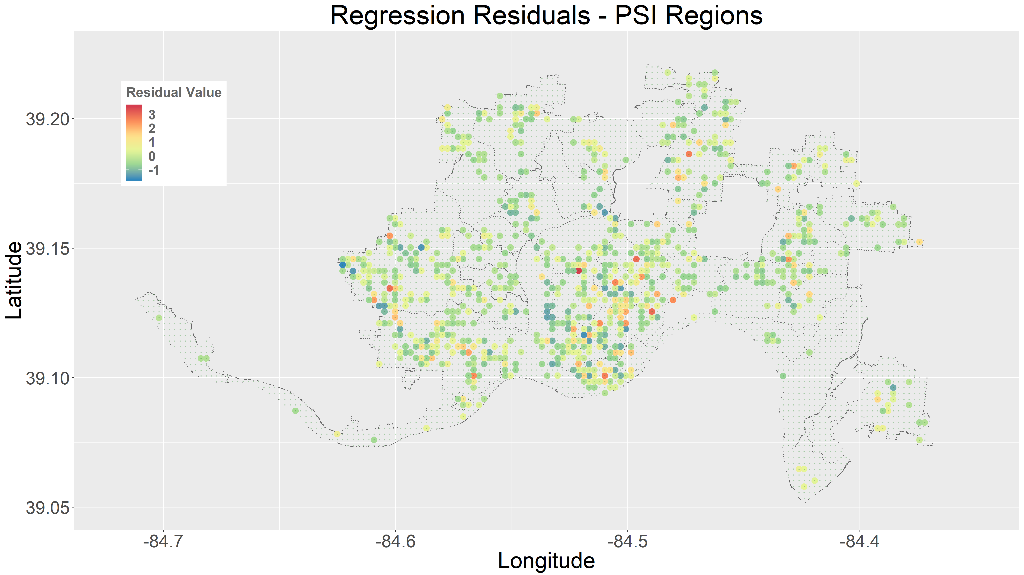
Visualization of Results
Avondale
Westwood
Clifton
Walnut Hills

Slide 23
Visualization of Results – Cont. 1/2
Avondale
Westwood
Clifton
Walnut Hills

Slide 24
Visualization of Results – Cont. 2/2
Avondale
Westwood
Clifton
Walnut Hills

Slide 25
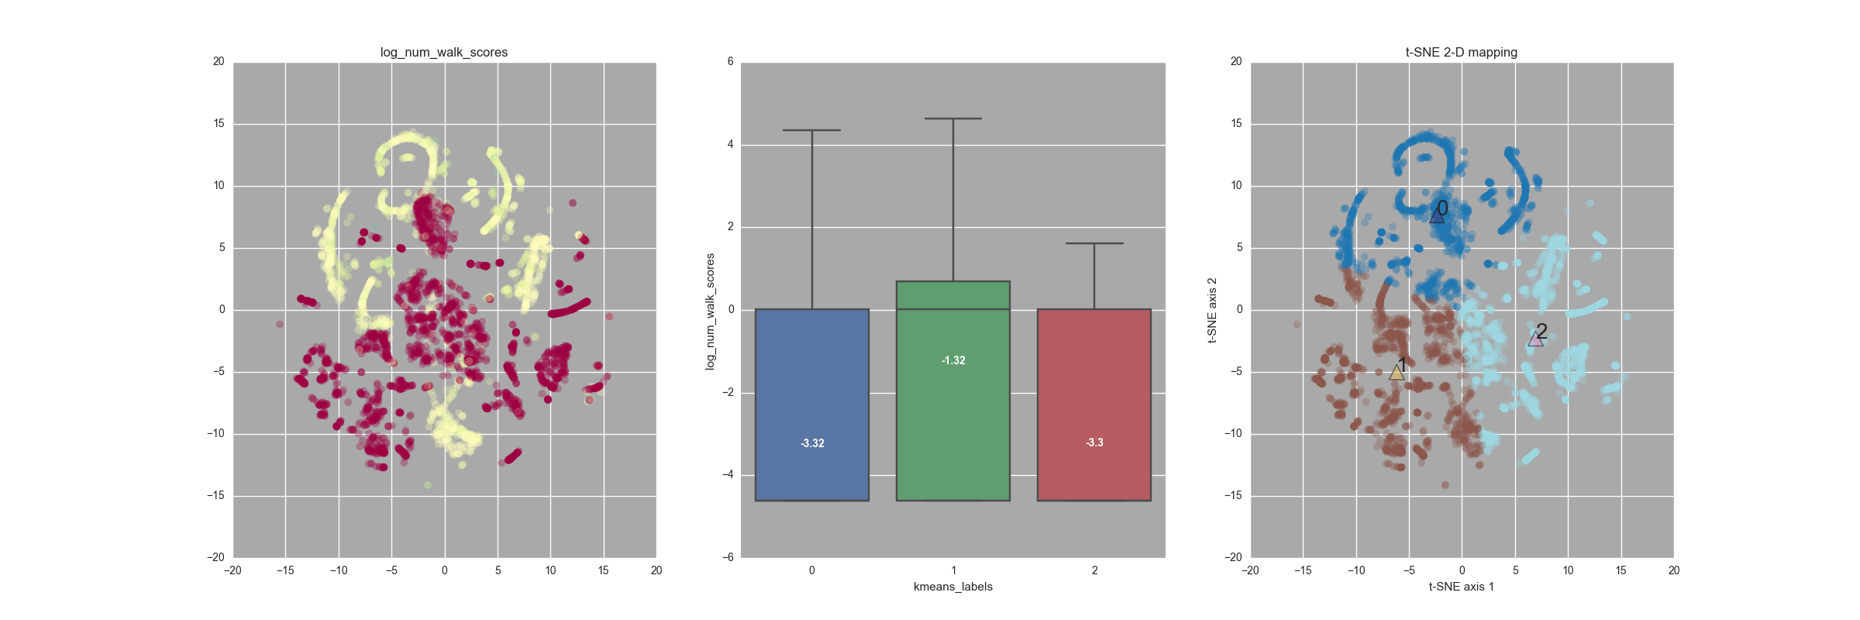
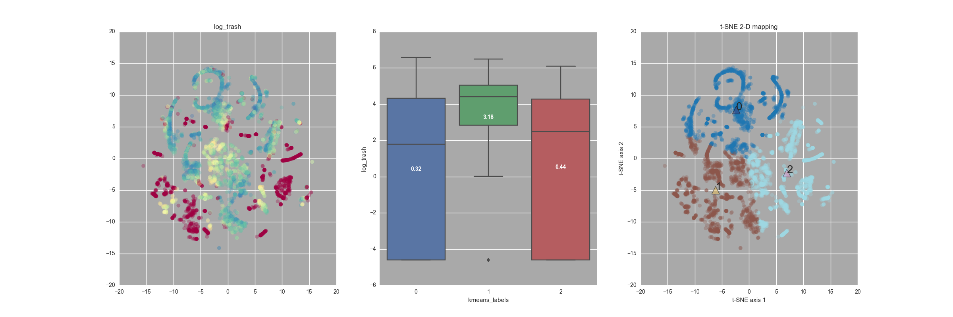
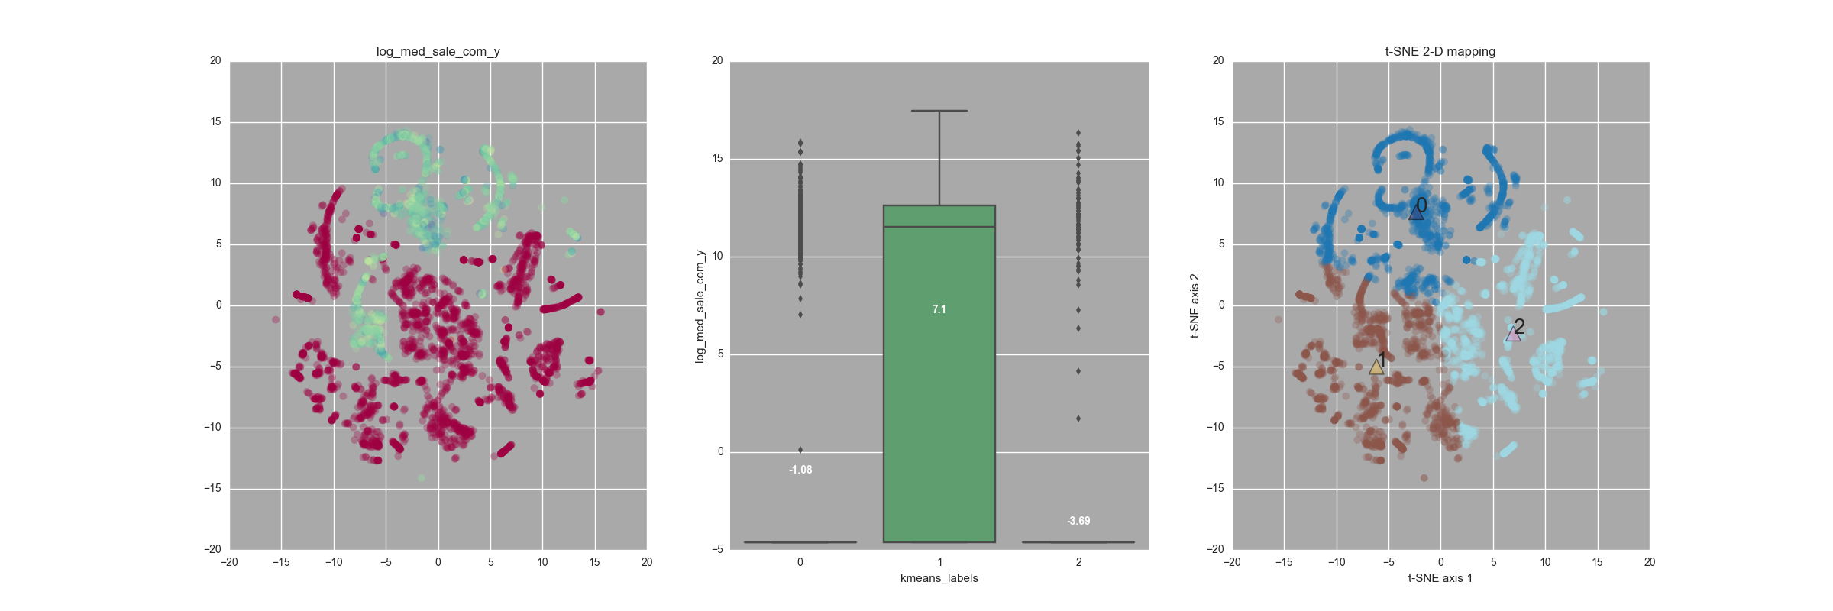
Non-Supervised Learning – K-means Clustering
Walk Scores
Magnitude distribution of feature
Box plot distribution of property values for each cluster
k-means cluster identification in
t-SNE 2D mapping
Service Requests - trash
Commercial Property Values
highest in 2nd cluster
concentrated in 2nd cluster
25

Slide 26
Non-Supervised Learning – K-means Clustering
Walk Scores
Magnitude distribution of feature
Box plot distribution of property values for each cluster
k-means cluster identification in
t-SNE 2D mapping
Service Requests - trash
Commercial Property Values
highest in 2nd cluster
concentrated in 2nd cluster
26

Slide 27
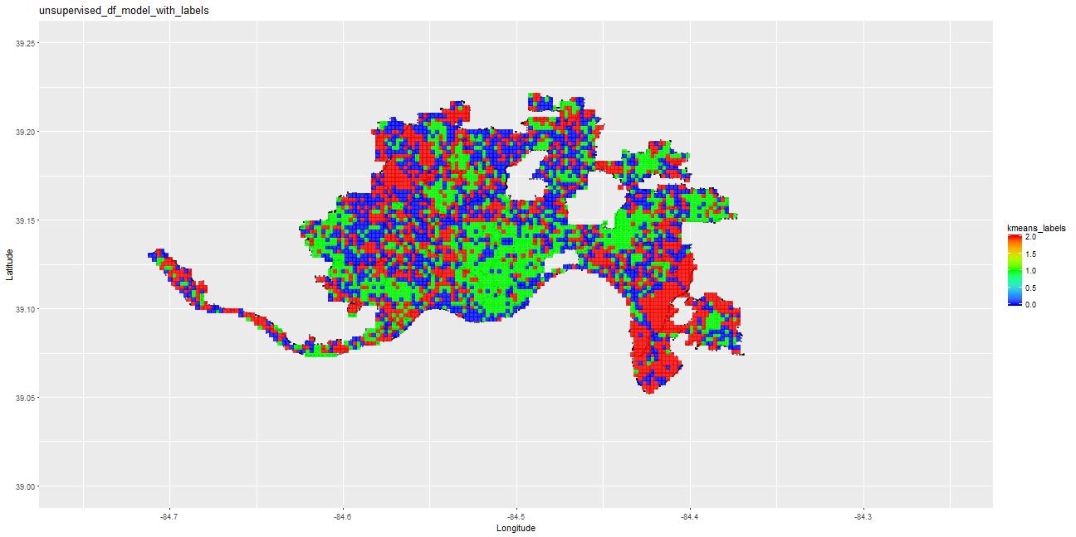
Non-Supervised Learning - Observations
Blue areas are mostly residential
Green areas have better overall walk score, with a mean score of 54. This falls under "Somewhat walkable, Some errands can be accomplished by walk" of the walk score description.
**** Over-The-Rhine, Mt. Auburn and Central Business District are three neighborhoods with a good walk score, qualifying for "Very walkable" conditions.
Red areas mostly complain about metal trash, while blue area complain about insect and animal related service requests.
Pedestrian-Signal issues like vehicles running stop signs, short walk signals, vehicles that do not yield at crosswalks, and lack of visibility are mainly around Oakely, Clifton, Hyde Park, Madisonville, Pleasant Ridge.
Most Water leaks are predominantly in green.
27

Slide 28
Non-Supervised Learning - Observations
Blue areas are mostly residential
Green areas have better overall walk score, with a mean score of 54. This falls under "Somewhat walkable, Some errands can be accomplished by walk" of the walk score description.
**** Over-The-Rhine, Mt. Auburn and Central Business District are three neighborhoods with a good walk score, qualifying for "Very walkable" conditions.
Red areas mostly complain about metal trash, while blue area complain about insect and animal related service requests.
Pedestrian-Signal issues like vehicles running stop signs, short walk signals, vehicles that do not yield at crosswalks, and lack of visibility are mainly around Oakely, Clifton, Hyde Park, Madisonville, Pleasant Ridge.
Most Water leaks are predominantly in green.
28

Slide 29
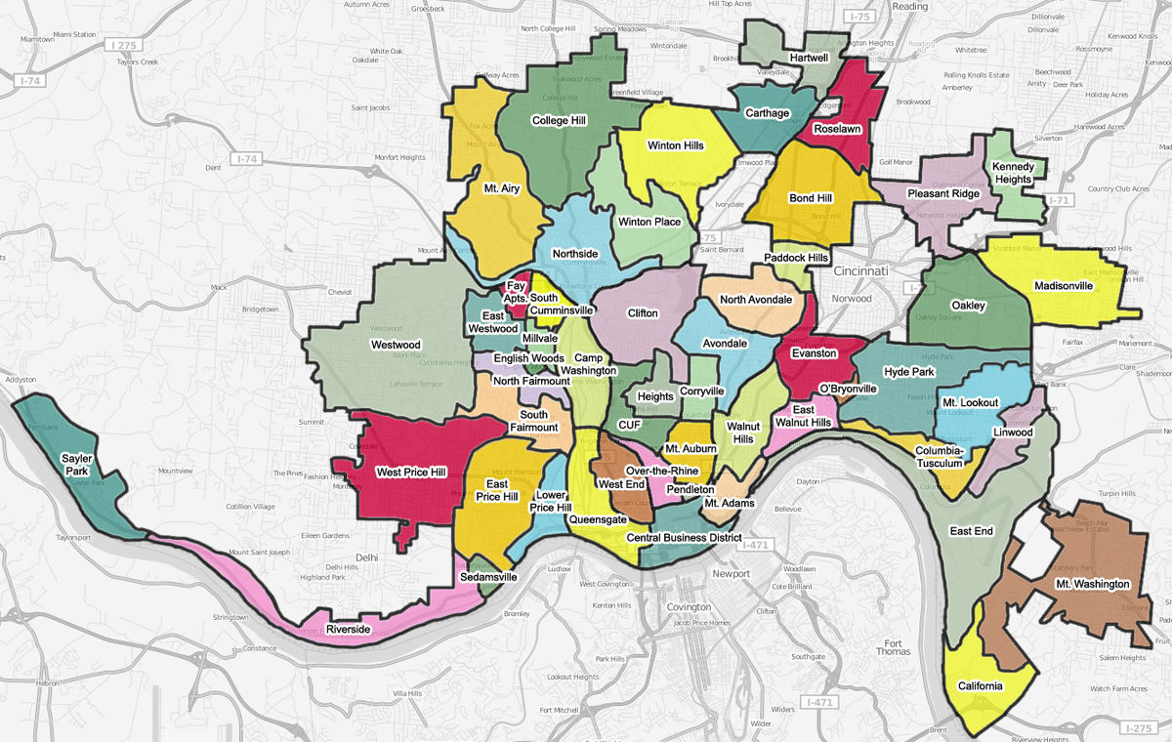
Non-Supervised Learning
Cluster 0: Blue
Property Type:
Residential
Top Issues:
Animals and Insects
Unkempt Vegetation
Vehicles Running Red Lights and Stop Signs
Cluster 1: Green
Property Type: Commercial
Top Issues:
Speeding
Water Leaks
Heavy Traffic
Vehicles not Yielding
Cluster 2 : Red
Property Type:
Industrial
Top Issues:
Metal Trash
Cars Unable to Find Parking
Lack of Sidewalks
Potholes
29

Slide 30
Non-Supervised Learning
Cluster 0: Blue
Property Type:
Residential
Top Issues:
Animals and Insects
Unkempt Vegetation
Vehicles Running Red Lights and Stop Signs
Cluster 1: Green
Property Type: Commercial
Top Issues:
Speeding
Water Leaks
Heavy Traffic
Vehicles not Yielding
Cluster 2 : Red
Property Type:
Industrial
Top Issues:
Metal Trash
Cars Unable to Find Parking
Lack of Sidewalks
Potholes
30

Slide 31
Conclusions
PSI Regions Identified
~30 grid cells targeted from random forest binary model
RF Binary model – 75% TP / 20% FP Rate
Regression – R² consistent with published results from other cities
Influential Factors
Non-pedestrian involved accidents
Public transportation accessibility
Number of service requests for buildings, sidewalk, and vegetation
Non-Supervised Learning
Westwood, Mt. Washington and East End
Speeding vehicles and non-yielding to pedestrians
Clifton, Madisonville, Walnut Hills and Mt. Washington
Construct additional sidewalks and crosswalks
Over-the-Rhine, Downtown and Clifton
Increase bike-ability
31

Slide 32
Conclusions
PSI Regions Identified
~30 grid cells targeted from random forest binary model
RF Binary model – 75% TP / 20% FP Rate
Regression – R² consistent with published results from other cities
Influential Factors
Non-pedestrian involved accidents
Public transportation accessibility
Number of service requests for buildings, sidewalk, and vegetation
Non-Supervised Learning
Westwood, Mt. Washington and East End
Speeding vehicles and non-yielding to pedestrians
Clifton, Madisonville, Walnut Hills and Mt. Washington
Construct additional sidewalks and crosswalks
Over-the-Rhine, Downtown and Clifton
Increase bike-ability
32

Slide 33
Conclusions
PSI Regions Identified
~30 grid cells targeted from random forest binary model
RF Binary model – 75% TP / 20% FP Rate
Regression – R² consistent with published results from other cities
Influential Factors
Non-pedestrian involved accidents
Public transportation accessibility
Number of service requests for buildings, sidewalk, and vegetation
Non-Supervised Learning
Westwood, Mt. Washington and East End
Speeding vehicles and non-yielding to pedestrians
Clifton, Madisonville, Walnut Hills and Mt. Washington
Construct additional sidewalks and crosswalks
Over-the-Rhine, Downtown and Clifton
Increase bike-ability
33

